Slide 1
Lecture 16: Lingering Questions and A Basic Case Study

Slide 2
Lecture Outline
A Little Review: some lingering questions
Some HW feedback
The Data Science Process: A Basic Case Study

Slide 3
Some Lingering Questions

Slide 4
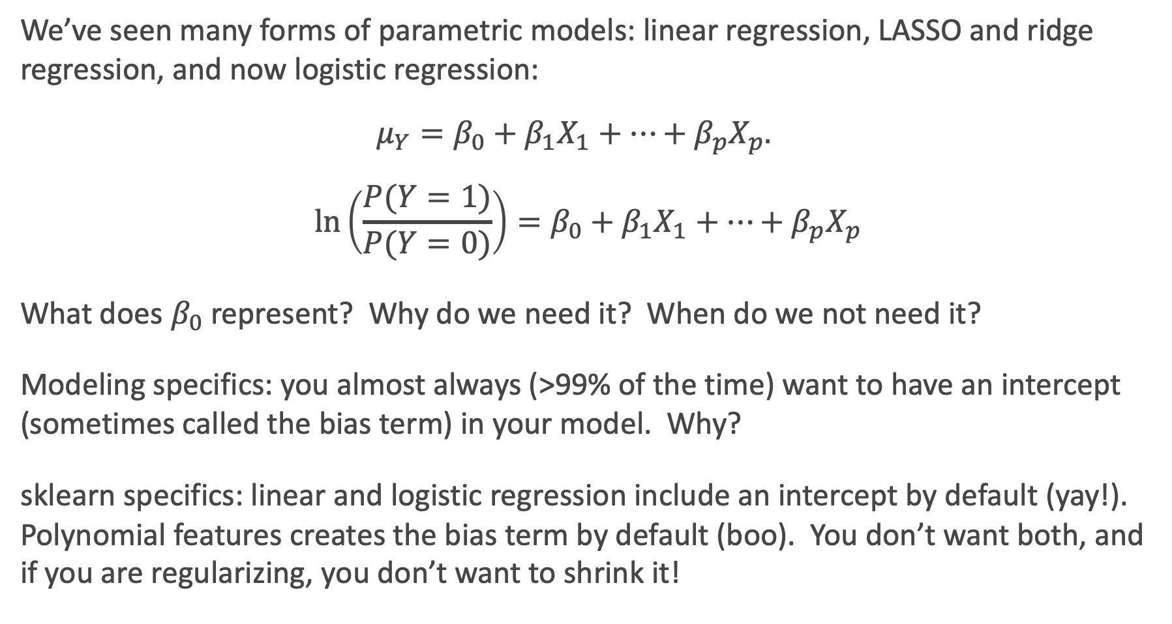
What’s the deal with the Intercept?
We’ve seen many forms of parametric models: linear regression, LASSO and ridge regression, and now logistic regression:
$$μ_{Y}=β_{0}+β_{1}X_{1}+…+β_{p}X_{p}.$$
$$\ln\left(\frac{P(Y=1)}{P(Y=0)}\right)=β_{0}+β_{1}X_{1}+…+β_{p}X_{p}$$
What does $β_{0}$ represent? Why do we need it? When do we not need it?
Modeling specifics: you almost always (>99% of the time) want to have an intercept (sometimes called the bias term) in your model. Why?
sklearn specifics: linear and logistic regression include an intercept by default (yay!). Polynomial features creates the bias term by default (boo). You don’t want both, and if you are regularizing, you don’t want to shrink it!

Slide 5
What’s the difference: Standardize vs. Normalize
What is the difference between Standardizing and Normalizing a variable?
Normalizing means to bound your variable’s observations between zero and one. Good when interpretations of “percentage of max value” makes sense.
Standardizing means to re-center and re-scale your variable’s observations to have mean zero and variance one. Good to put all of your variables on the same scale (have same weight) and to turn interpretations into “changes in terms of standard deviation.”
Warning: the term “normalize” gets incorrectly used all the time (online, especially)!

Slide 6
To Standardize, or Not to Standardize, that is the question…
When should you do each?
Normalizing is only for improving interpretation (and dealing with numerically very large or small measures). Does not improve algorithms otherwise.
Standardizing can be used for improving interpretation and should be used for specific algorithms. Which ones? Regularization and k-NN (so far)!
For best interpretations, do not change the scale from the original units.
*Note: you can standardize without assuming things to be [approximately] Normally distributed! It just makes the interpretation nice if they are Normally distributed.

Slide 7
(Train & Validation) & Test Splits
What is the proper use of Train, Validation, and Test Splits? What is the purpose?
Purpose: to select and evaluate a predictive model. Not needed for interpretative models.
The test set is used only for evaluating the error of the model (and used just once).
The (train & validation) sets are used to estimate/fit and select between models, respectively.
Since it is so important to choose your best predictive model, we often perform cross validation so that a single random validation set does influence this decision.
Note: you should refit the model on the entire (Train & Validation) set after choosing the best model.

Slide 8
It’s funny, because it’s a train

Slide 9
A few other lingering thoughts:
What happens when multicollinearity is present? Why is multicollinearity bad? Why is it not always bad? How can this be handled?
How does a multiple regression model for 2 predictors (one binary, the other quantitative) compare in interpretation when the interaction is included vs. not included in the model. How can we visualize this?
Why is one of the binary/dummy terms dropped out of the predictor set when modeling a categorical predictors?

Slide 10
Some Regularizing Details
Why is the intercept term not penalized in regularized methods? What if it was penalized?
When is LASSO preferred over Ridge? What about the other way around?
How do regularization methods affect multicollinearity?

Slide 11
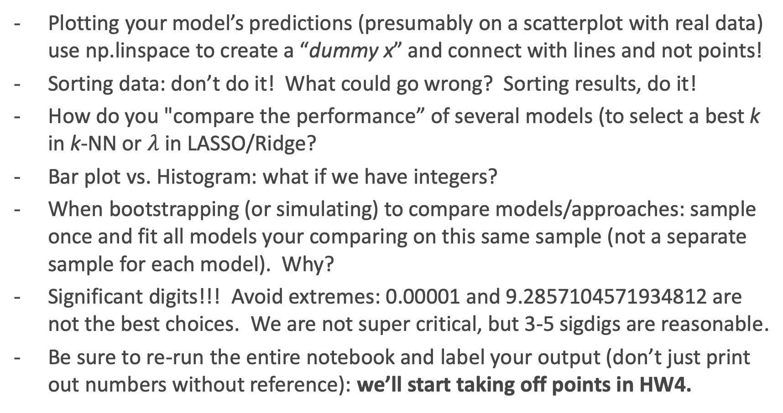
Suggestions/Comments about HW
Plotting your model’s predictions (presumably on a scatterplot with real data) use np.linspace to create a “dummy x” and connect with lines and not points!
Sorting data: don’t do it! What could go wrong? Sorting results, do it!
How do you "compare the performance” of several models (to select a best k in k-NN or $λ$ in LASSO/Ridge?
Bar plot vs. Histogram: what if we have integers?
When bootstrapping (or simulating) to compare models/approaches: sample once and fit all models your comparing on this same sample (not a separate sample for each model). Why?
Significant digits!!! Avoid extremes: 0.00001 and 9.2857104571934812 are not the best choices. We are not super critical, but 3-5 sigdigs are reasonable.
Be sure to re-run the entire notebook and label your output (don’t just print out numbers without reference): we’ll start taking off points in HW4.

Slide 12
The Data Science Process: A ‘Case Study’

Slide 13
The Data Science Process
I started with some interesting questions. I wanted to address:
The wage gap. There is actually lot of publicly available salary data out on the web. But the data do not include sex/gender/race/ethnicity, and are typically volunteered.
The effect of COVID-19 on various things: mental health, media consumption, etc. Publicly available data is very spotty. Or not raw enough to be useful. Or very expensive (see, Nielsen cost).
I browsed Kaggle Competitions for interesting questions they have. Nothing tickled my fancy.
So I called an audible…
Ask an interesting question
Get the Data
Explore the Data
Model the Data
Communicate/Visualize the Results

Slide 14
Do you like…stuff?
I like movies. Let’s start our process by considering a data set from Kaggle:
https://www.kaggle.com/tmdb/tmdb-movie-metadata
What should we do first?
Ask an interesting question
Get the Data
Explore the Data
Model the Data
Communicate/Visualize the Results

Slide 15
First Glimpse at the Data
Explore the Data
What are some EDAs we should perform?

Slide 16
First EDA of the Data
Explore the Data
What are some necessary cleaning and wrangling tasks?
What other EDAs we should perform?

Slide 17
Breakout #1 Tasks (15-20min): 1. Someone share (the person who resides closest to the Bahamas…thanks Columbus). Someone different will share in the next breakout. 2. Explore the data (some of that is done with you with code). Please do a little more exploration. 3. Come up with an interesting question or two you can answer with this data set. Come up with a question or two that can be answered with supplemental data: - start with ideal, and then get more practical based on what is likely available.

Slide 18
Any interesting questions?
What are some interesting questions you came up with for this data set?
What are some interesting questions using supplemental data?
Ask an interesting question
Get the Data
Explore the Data
Model the Data
Communicate/Visualize the Results

Slide 19
My questions:
I came up with simple questions (and pretty straight-forward one for now):
#1: How is revenue associated with budget?
#2: How has this evolved over time?
#3: What other factors relate to revenue of a movie?
Ask an interesting question
Get the Data
Explore the Data
Model the Data
Communicate/Visualize the Results

Slide 20
Back to exploring:
Ask an interesting question
Get the Data
Explore the Data
Model the Data
Which is more appropriate for linear modeling (or any regression modeling, really)? What issues arise? What should we do about it?
Communicate/Visualize the Results

Slide 21
Breakout #2 Tasks (20+min): 1. Someone else share and take notes (who resides furthest from the Bahamas) 2. Solidify your question(s) of interest. 3. Determine the next tasks: - What other data do you need? How will this data be collected and combined? - What data cleaning and wrangling tasks are needed? - What other EDA is necessary? What visuals should be included? - What is a goal for a first baseline model (Key: should be interpretable)? Be sure to include the class of model and the variables involved. - What is a reasonable goal for a final model and product? 4. Determine how long each task should take. 5. Assign next tasks to group members. Do not actual perform these tasks!

Slide 22
Scoping and Redefining the Problem
How did that go?
What is the biggest concern you have at this point for your questions?
Can these data answer your questions?
What supplemental data would be required?
What idealistic questions did you shy away from?
What models are you considering?

Slide 23
Scoping and Redefining your Project
This lecture is relevant for your group project:
Milestone 2 (due next week on Friday) is to scope and redefine your project.
You should converse with your group members to:
(a) Redefine the problem, if appropriate
For example: maybe you want to not use the Boston Crime data set, but instead use the FBI’s data for white collar crime).
(b) Scope your project
What are the next tasks? Who will perform what ?
What is a reasonable goal for a baseline model?
What are both ideal and reasonable goals for a final model and product?)
*feel free to consult with your assigned TF in a message or two.

Slide 24
My question:
What models should be considered for these questions?
#1: How is revenue associated with budget?
#2: How has this evolved over time?
#3: What other factors relate to revenue of a movie?
How could these models be communicated?
Ask an interesting question
Get the Data
Explore the Data
Model the Data
Communicate/Visualize the Results

